Slide 1
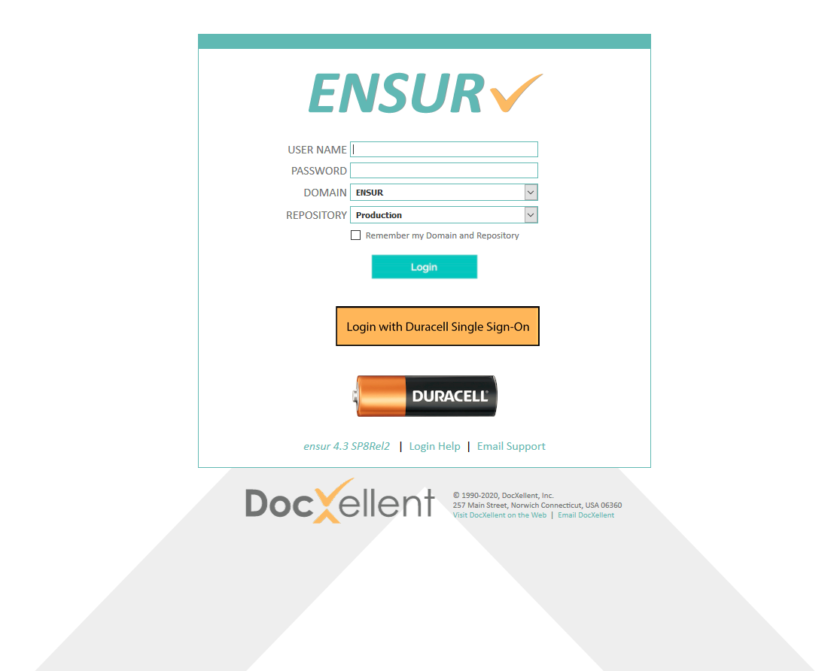

How do I log in to ENSUR?
Only use this ENSUR login if you do not have SSO credentials, or if you were notified to log in this way.
Important Notice: ENSUR supports most browsers, but Internet Explorer is obsolete and should not be used.
Google Chrome, Microsoft Edge and Mozilla Firefox are preferred.
Type your User ID (not your email address) here
Type your password here
(Click to continue)
Follow the instructions provided to select either:
ENSUR (if an administrator assigned you a password), or
CORP.DURACELL.COM (if you were instructed to use your Duracell ID to login)
Users given Duracell SSO credentials should use Single Sign-On by clicking here (unless otherwise notified).
(Click to continue)
Use the default repository as shown
(Click to continue)
(Otherwise,
click to continue)
(Click to continue)
(Click to continue)
Important Note: Each user has only one way to log in. If you select the wrong one, close your browser and try again.

Slide 2
To get help
Contact an ENSUR system administrator, by email, phone, or Skype
  Email: ENSUR-HELP@duracell.com
  Product system administrators:
    Bonnie Mould mould.bf@duracell.com
  Packaging system administrators:
    Karen Peterson peterson.km@duracell.com
    Natalya Frenkel frenkel.n@duracell.com
  OR
Contact the Duracell Help Desk

